Slide 1
NOTATIONAL ANALYSIS
Guidelines for seminar papers
Ivan Belčić, PhD

Slide 2
Seminar paper
Theme (dominant sport or sport according to preferences)
League / competition / match
Recording / gathering video material
Choose performance indicators (minimum 5)
Video material analysis (hand or computer notational systems)
Writing of paper according to guidelines

Slide 3
Seminar paper - Guidelines
Language – standard english language (3rd)
Font – Times New Roman
  Font size: 12
  Titles (big letters): 14
    Subtitles: 14
Margines 2,5 cm on each side
  Spacing – 1,5
  Spacing interval – before and after – 0 pt
  Text must be justified on both sides
Minimum 1500 words

Slide 4
Seminar paper - Guidelines
Intorduction
Methods
Performance indicators
Critical situations
Discussion and results
Conclusions
References (minimal 10 references)

Slide 5
Seminar paper - INTRODUCTION
Notational analysis of chosen sport:
  Basic data about sport
  Theoretical background
  Application of previous notational analysis in chosen sport
  Previous researches
  Most common used performance indicators
Science-based facts - be sure to cite in each part of the seminar where the reference was used

Slide 6
Seminar paper – METHODS
Describe the detailed procedure for notational analysis
Entity sample
Description of protocols, measuring instruments
Video source / statistics source
Equipment (if used)
Program (if used - item repository)
Statistical methods of data processing

Slide 7
*PERFORMANCE INDICATORS
Select at least five (5) and define each
1. Entity (player)
2. Performance indicator (variable)
3. Time during the match / competition
4. Outcome (successful / unsuccessful; in box / out of box;…)
Unique performance indicator models required for notational analysis (depending on coach, staff, competition rank, reporting method,…)

Slide 8
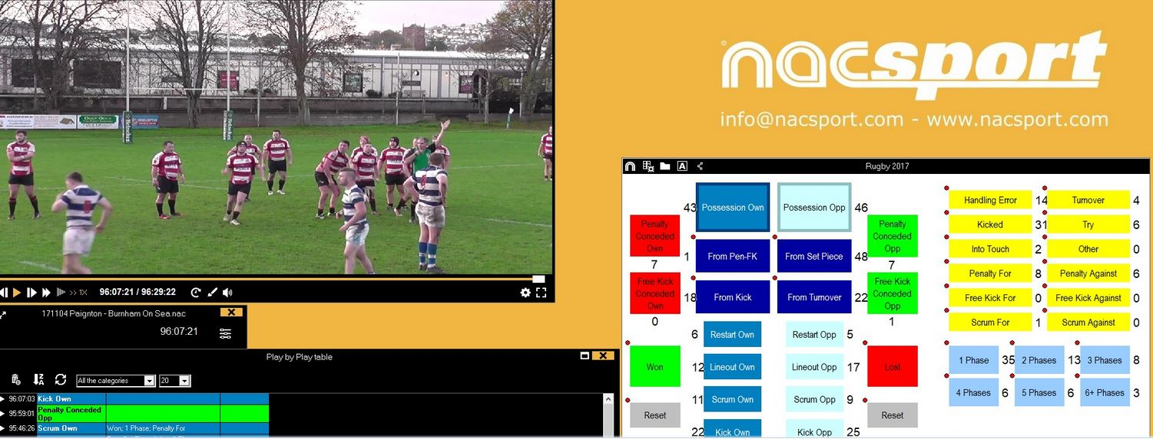
Seminar paper– PERFORMANCE INDICATORS
Describe performance indicators
Select at least five (5) and define each
Graph and describe the notation system used
Explain why these performance indicators were chosen

Slide 9
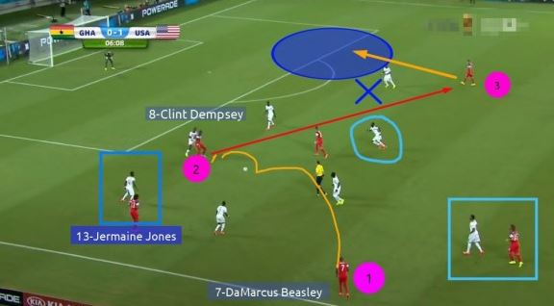
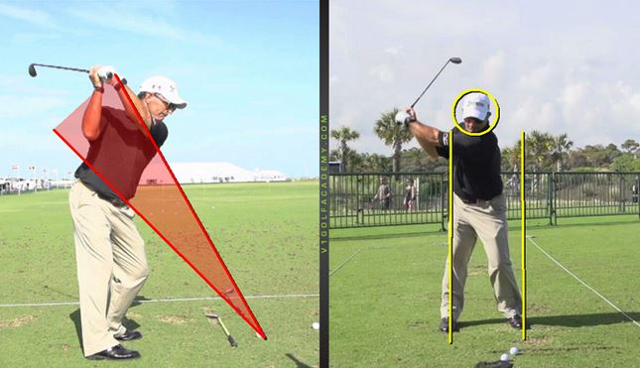
Seminar paper – CRITICAL SITUATIONS
Describe critical situations
Select at least three (3) critical situations
Display and Describe (Video Presentation)
Previous research on critical situations and related to your chosen sport
Explain why do you think these were critical situations

Slide 10
Seminar paper – DISCUSSION AND RESULTS
Graphic representation of results
Describe the results obtained by all performance indicators
Describe the differences and similarities between the variables analyzed
Why are these results obtained?
Express your own thoughts

Slide 11
Seminar paper – CONCLUSION
Practical application of the results obtained in the chosen sport
Why are the results obtained relevant?
Future research should…

Slide 12
Seminar paper – REFERENCES
Source is any form of material, regardless of medium, whether printed or electronic, that you use to create a seminar paper (text, graphic, photograph, encyclopedia)
The American Psychological Association APA citation style is used at the Faculty of Kinesiology:
  https://www.mendeley.com/guides/harvard-citation-guide

Slide 13
Seminar paper – THEMES
Match analysis in selected performance metrics
Performance indicators during the 2018/2019 season
Analysis or difference between leagues in specific performance metrics
Notational analysis in a particular sport - theoretical seminar
Key performance indicators in handball that affect the outcome of a match
SOURCES:
EHF, IHF, FIFA, flashscore.com, FIBA, FIVB,…

Slide 14
DEADLINE FOR SEMINAR PAPERS
19.12.2019.
E-MAIL:
ivan.belcic@kif.hr
Subject:
ERASMUS – NA – name and surname

